Slide 1
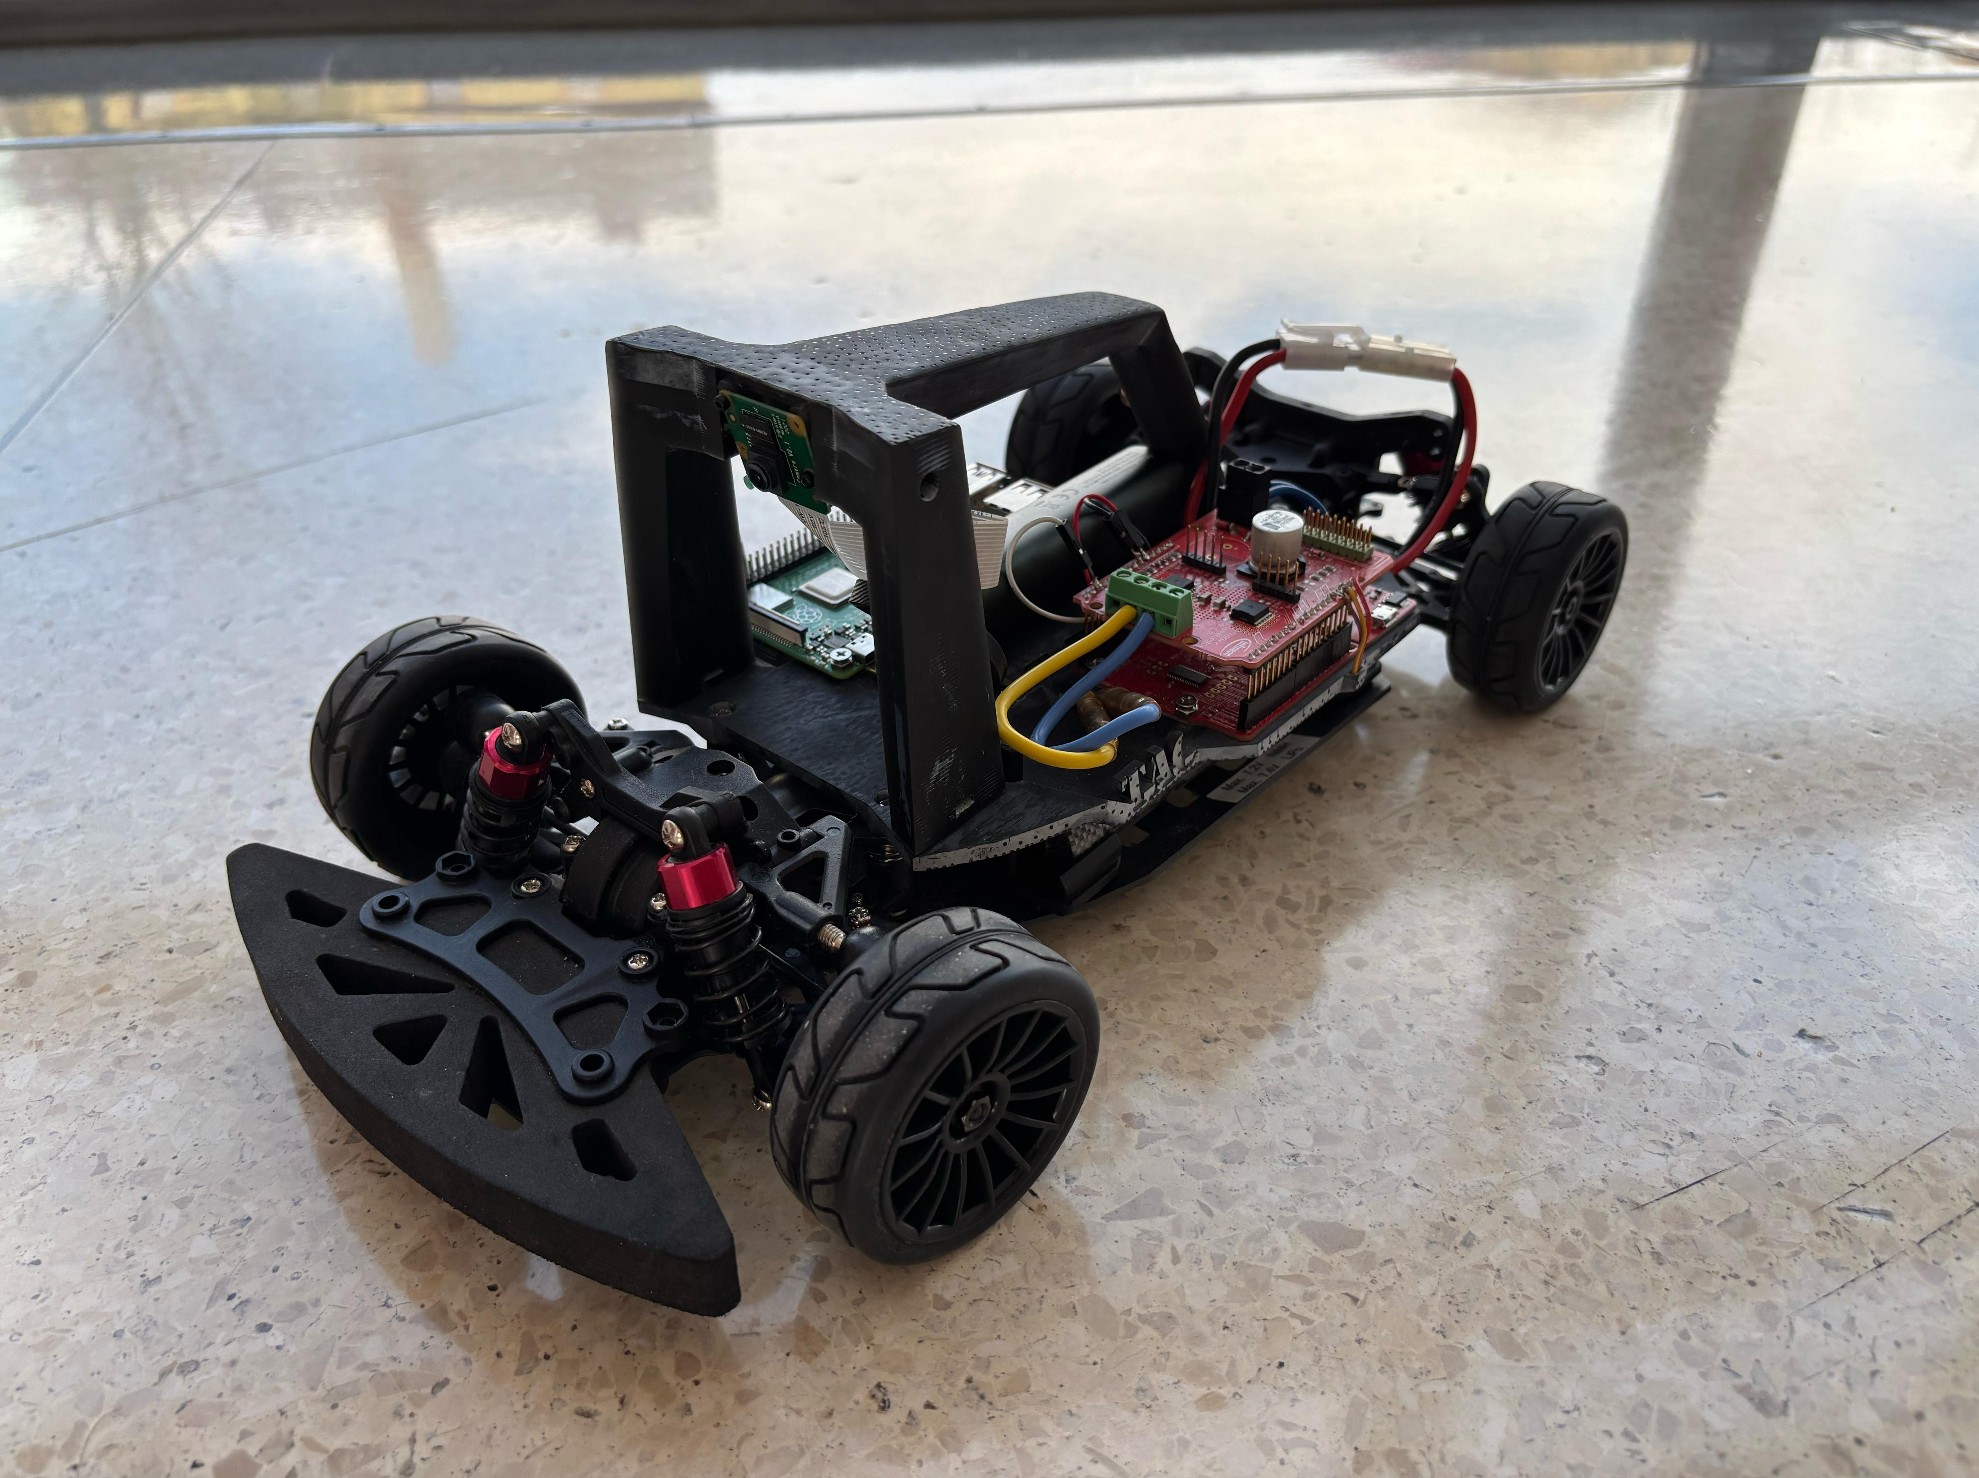
AI-BASED
SMART VEHICLE
Adaptive Cruise Control | Lane Assistance | Obstacle Detection
ENTC MEGA PROJECT
Hardware prototype with AI-based perception and real-time control
AI VISION
SAFETY
AUTOMATION
AI-Based Smart Vehicle | ENTC Mega Project

Slide 2
Why a Smart Vehicle?
02
The project combines electronics, embedded systems, AI and automotive control.
1 SENSE
2 THINK
3 ACT
Camera, ultrasonic and IR sensors observe the vehicle environment.
Raspberry Pi processes sensor data and runs computer-vision logic.
Controller drives motors, steering and safety warnings.
Goal
Build a small, reliable vehicle that demonstrates real ADAS concepts on a tabletop track.
AI-Based Smart Vehicle | ENTC Mega Project

Slide 3
System Architecture
03
Perception → decision → actuation.
Camera
Lane + objects
RASPBERRY PI
ESP32 / ARDUINO
Ultrasonic
AI / OpenCV
Decision Logic
Sensor Fusion
Real-time I/O
PWM control
Distance
IR Sensors
Lane position
Motor Driver
Servo
Speed control
Steer
AI-Based Smart Vehicle | ENTC Mega Project

Slide 4
Hardware Components
04
Practical hardware for a compact ENTC prototype.
Raspberry Pi 4/5
Pi / USB Camera
ESP32 / Arduino
AI + computer vision
Lane & object detection
Low-level control
4WD Chassis + Motors
Motor Driver
Servo Motor
Vehicle platform
Motor interface
Steering
Ultrasonic ×2–3
IR Sensors
OLED / Buzzer / LEDs
Obstacle distance
Lane tracking
Status & warning
Battery + Regulator
Optional GPS
Emergency Stop
Power supply
Location
Safe testing
AI-Based Smart Vehicle | ENTC Mega Project

Slide 5
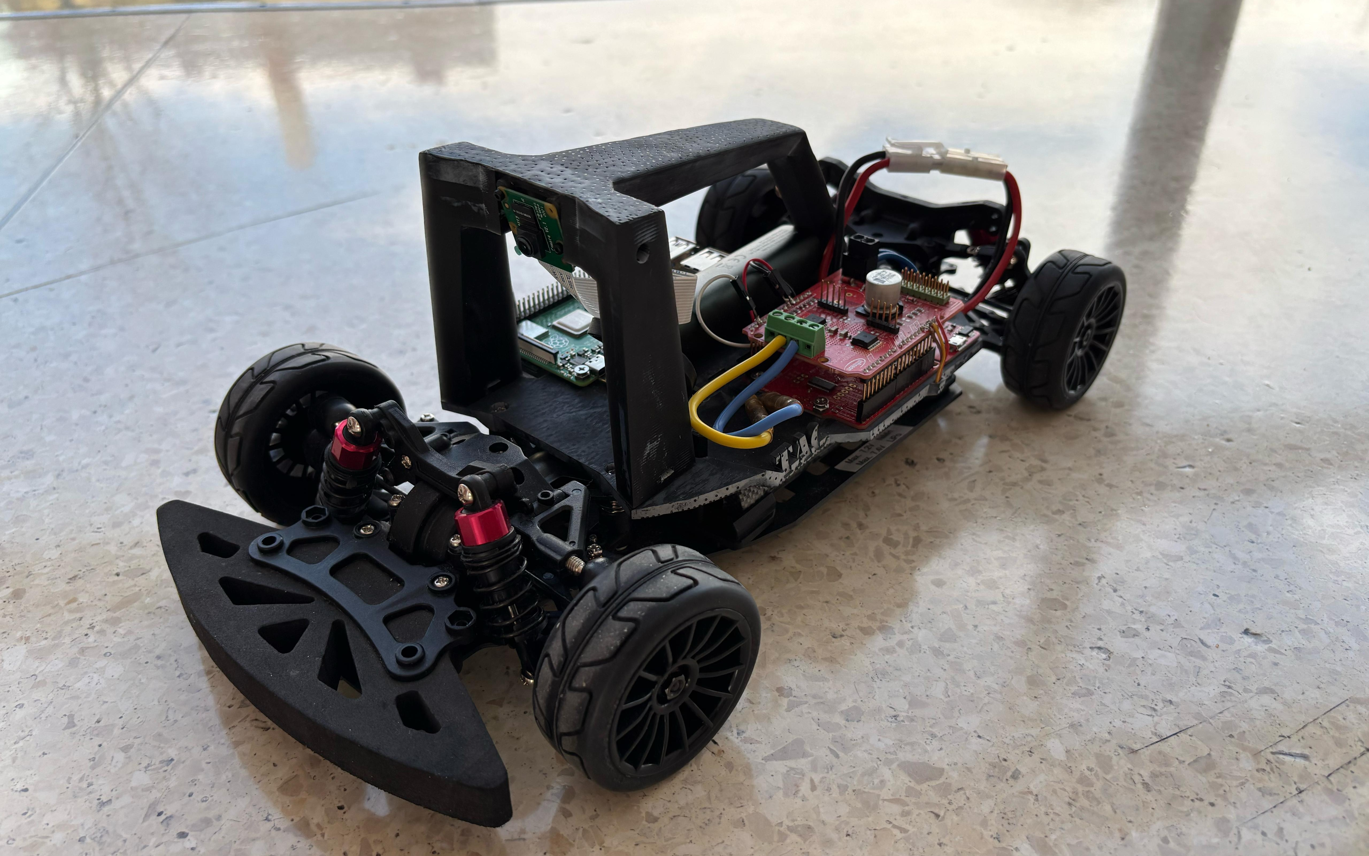
Prototype Hardware Reference
05
Real small-scale autonomous-car hardware uses a camera, Raspberry Pi and vehicle chassis.
Camera
Mounted high/front for road and object perception.
Compute
Raspberry Pi acts as the AI processing brain.
Drive system
Motors + driver + steering actuator convert decisions into motion.
Reference hardware image
AI-Based Smart Vehicle | ENTC Mega Project

Slide 6
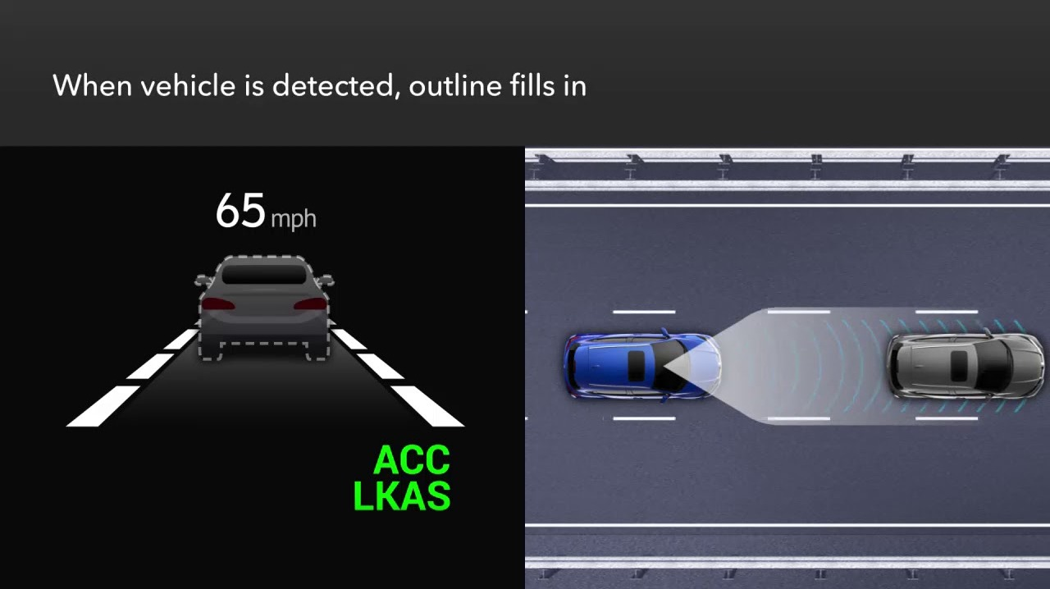
Adaptive Cruise Control
06
Maintain a target following distance by adjusting speed.
No vehicle ahead
Vehicle maintains the set model speed.
Vehicle detected
System reduces speed to maintain distance.
Too close
System commands braking / stop in the demo.
Concept reference: vehicle detection + lane tracking
AI-Based Smart Vehicle | ENTC Mega Project

Slide 7
Lane Assistance & Obstacle Detection
07
Two complementary safety behaviours.
LANE ASSISTANCE
OBSTACLE DETECTION
Obstacle
Detect lane center → steer correction
Measure distance → slow / stop
AI-Based Smart Vehicle | ENTC Mega Project

Slide 8
Working Sequence
08
A closed-loop demonstration from sensing to vehicle motion.
01
02
03
04
05
06
Sense
Process
Decide
Control
Act
Feedback
Camera + ultrasonic + IR
AI / computer vision
Speed + steering command
ESP32 + PWM + driver
Motors + servo + warning
Repeat continuously
Live demonstration: place an obstacle or lead vehicle → observe speed/stop response.
AI-Based Smart Vehicle | ENTC Mega Project

Slide 9
Tabletop Demonstration Model
09
Recommended setup: approximately 6 × 4 ft track.
ZONE A
Lane-following
Obstacle
ZONE B
Lead vehicle / ACC
SMART CAR
ZONE C
Obstacle stop
Dashboard
OLED: mode / speed / distance
AI-Based Smart Vehicle | ENTC Mega Project

Slide 10
Conclusion & Future Scope
10
A strong, demonstrable ENTC project without needing a full-size road.
What We Demonstrate
Future Enhancements
• AI-based perception
• Adaptive following distance
• Lane assistance
• Obstacle detection and stop
• Embedded motor + steering control
• LiDAR / depth camera
• Traffic-sign recognition
• Driver monitoring
• V2V / V2I communication
• CAN-based automotive network
• EV battery monitoring
THANK YOU
Questions?
AI-Based Smart Vehicle | ENTC Mega Project

